Slide 1
Turtlebot4 LLM
운영체제의 실제
안인규 (Inkyu An)

Slide 2
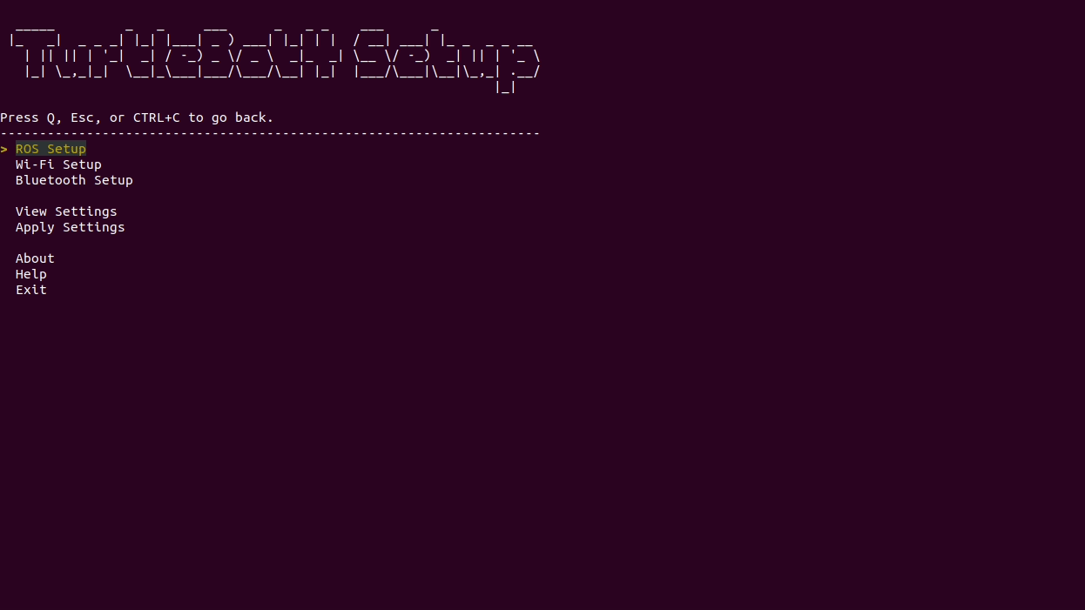
공유기 설정
Nav2를 사용하기 위해서는 외부망과 연결된 인터넷이 필수
Turtlebot4에 ssh로 접속
ros2 run turtlebot4_setup turtlebot4_setup
Wifi 설정 (오른쪽 그림 참고, 오타 조심!, 어려울 경우 TA에게 도움을 요청)
미래관 429호 (자율주행스튜디오)
SSID: SW_Turtlebot4_429_3(5G)
PW: swtest1!

Slide 3
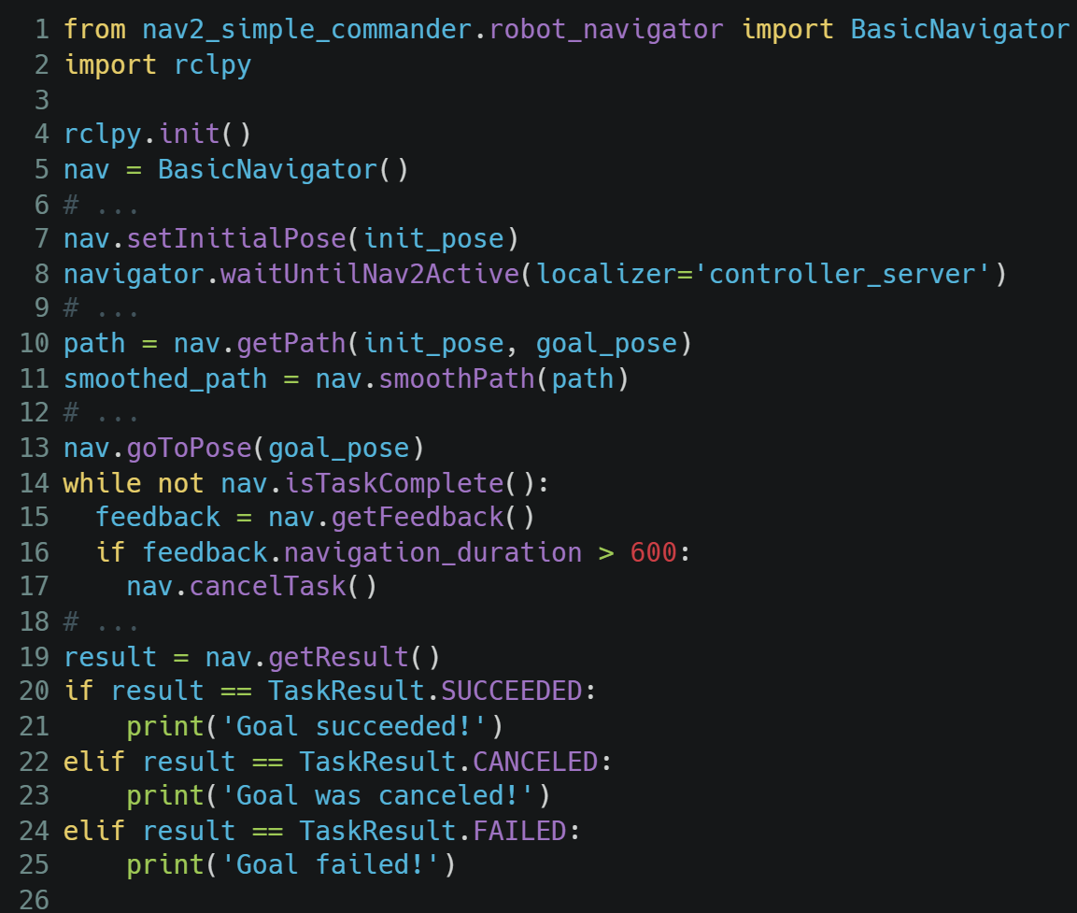
Nav2 – Commander API
from nav2_simple_commander.robot_navigator import BasicNavigator import rclpy rclpy.init() nav = BasicNavigator() # ... nav.setInitialPose(init_pose) navigator.waitUntilNav2Active(localizer='controller_server') # ... path = nav.getPath(init_pose, goal_pose) smoothed_path = nav.smoothPath(path) # ... nav.goToPose(goal_pose) while not nav.isTaskComplete(): feedback = nav.getFeedback() if feedback.navigation_duration > 600: nav.cancelTask() # ... result = nav.getResult() if result == TaskResult.SUCCEEDED: print('Goal succeeded!') elif result == TaskResult.CANCELED: print('Goal was canceled!') elif result == TaskResult.FAILED: print('Goal failed!')
Localization의 초기 위치 지정
Nav2가 online이 되길 기다림
경로 반환
부드러운 경로 생성
목적지까지 이동 명령
Navigation task가 완료될 때 까지 기다림
결과 확인

Slide 4
Nav2 – Commander API
from nav2_simple_commander.robot_navigator import BasicNavigator import rclpy rclpy.init() nav = BasicNavigator() # ... nav.setInitialPose(init_pose) navigator.waitUntilNav2Active(localizer='controller_server') # ... path = nav.getPath(init_pose, goal_pose) smoothed_path = nav.smoothPath(path) # ... nav.goToPose(goal_pose) while not nav.isTaskComplete(): feedback = nav.getFeedback() if feedback.navigation_duration > 600: nav.cancelTask() # ... result = nav.getResult() if result == TaskResult.SUCCEEDED: print('Goal succeeded!') elif result == TaskResult.CANCELED: print('Goal was canceled!') elif result == TaskResult.FAILED: print('Goal failed!')
We need to input the destination’s (x, y, z) coordinates through code
Localization의 초기 위치 지정
Nav2가 online이 되길 기다림
경로 반환
부드러운 경로 생성
목적지까지 이동 명령
Navigation task가 완료될 때 까지 기다림
결과 확인

Slide 5
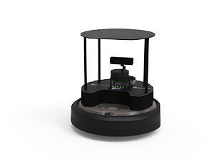

Command using Natural Language
Isn’t it possible to give commands using natural language? (e.g., Go to the toilet!)
In traditional navigation methods, you have to input the exact location of the toilet.
Go to the toilet!

Slide 6
Powered by LLM
LLMs are very powerful tools that can understand natural language.
LLMs are also very powerful tools that can understand computer languages (e.g., Python).

Slide 7
Powered by LLM
LLMs are very powerful tools that can understand natural language.
LLMs are also very powerful tools that can understand computer languages (e.g., Python).
What if an LLM received natural language input and generated Python code to control a robot?
Code as Policies: Language Model Programs for Embodied Control, Robotics at Google, arXiv 2022

Slide 8
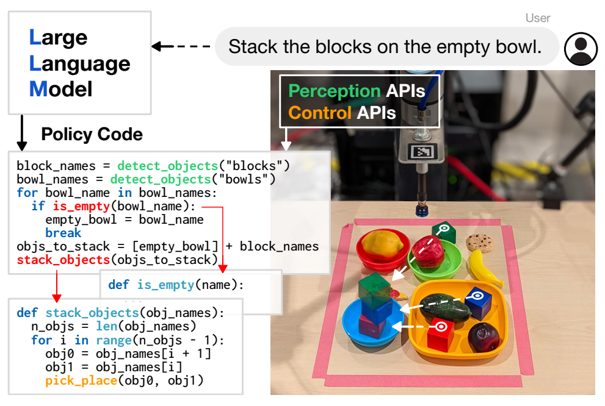
Code as Policies, Google
Language model generated programs (LMPs)
Robots can use code-writing LLMs to translate natural language commands into robot policy code which process perception outputs, parameterize control primitives, recursively generate code for undefined function

Slide 9
Code as Policies, Google
Language model generated programs (LMPs)
Robots can use code-writing LLMs to translate natural language commands into robot policy code which process perception outputs, parameterize control primitives, recursively generate code for undefined function
Only can understand “Text” (=Prompt)!

Slide 10
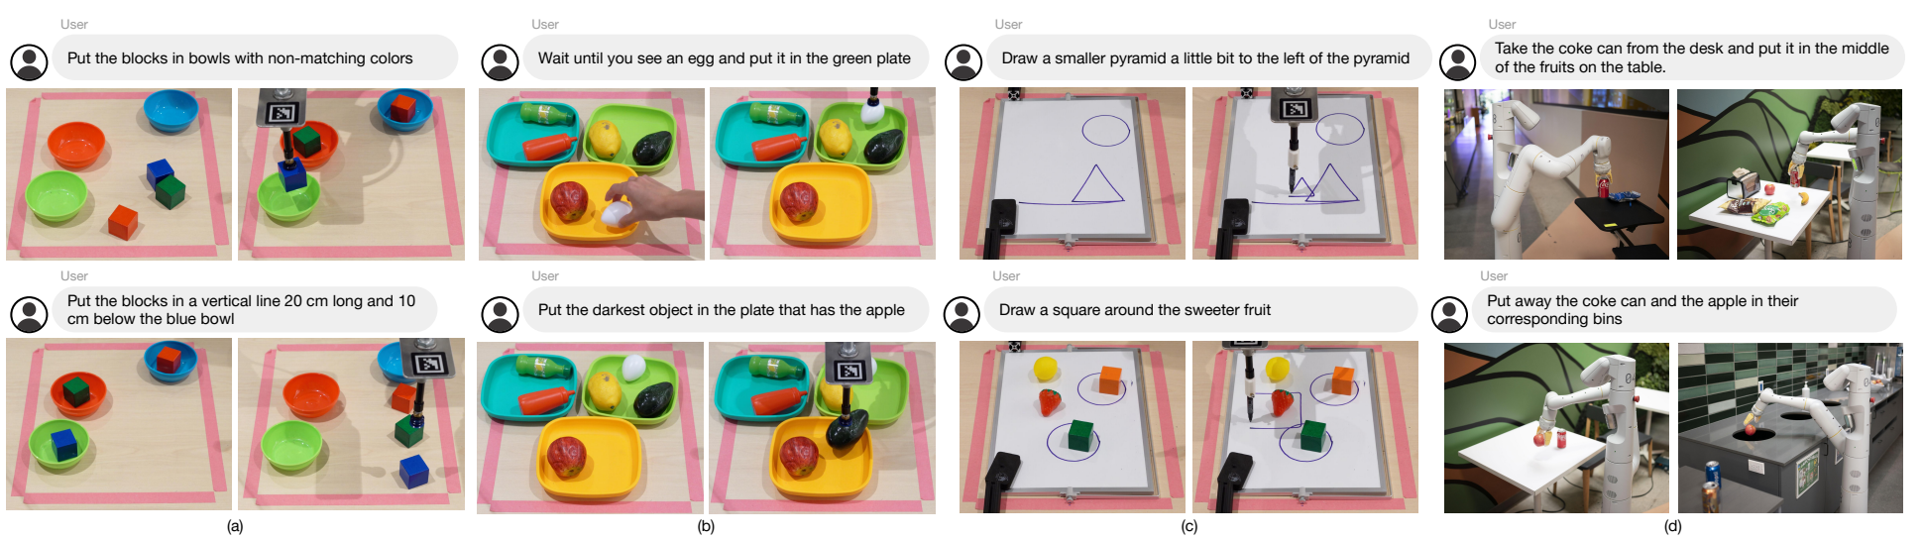
Code as Policies, Google
Language model generated programs (LMPs)
Input: 자연어 명령 (e.g., Put the red block on the green bowl)
Output: Python code
Prompt: Hints + Examples

Slide 11
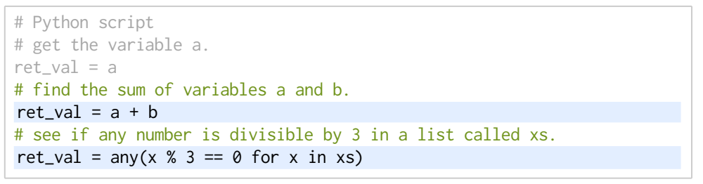
Code as Policies, Google
Prompt:
Hints: import statements that inform the LLM which APIs are available and type hints on how to use those APIs.
Example:
Input instructions are green / Generated Outputs are highlighted

Slide 12
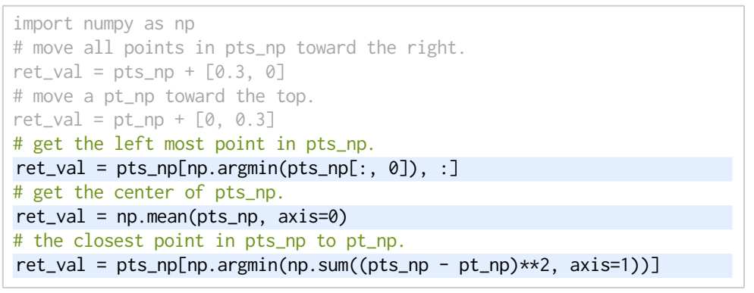
Code as Policies, Google
Prompt:
Hints: import statements that inform the LLM which APIs are available and type hints on how to use those APIs.
Example:
Input instructions are green / Generated Outputs are highlighted
Code-writing LLMs store knowledge of many popular libraries
Third-party libraries

Slide 13
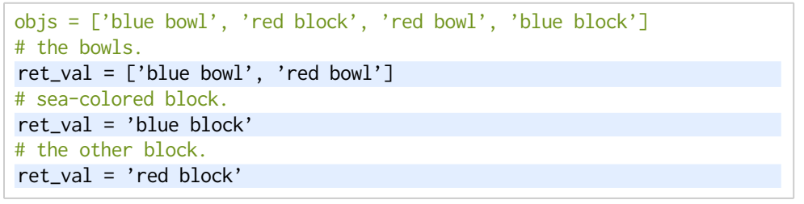
Code as Policies, Google
Prompt:
Hints: import statements that inform the LLM which APIs are available and type hints on how to use those APIs.
Example:
Input instructions are green / Generated Outputs are highlighted
Language reasoning

Slide 14
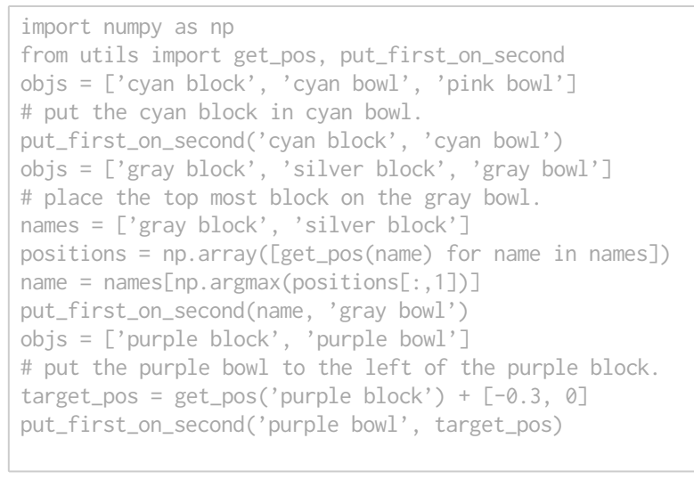
Code as Policies, Google
Prompt:
Hints: import statements that inform the LLM which APIs are available and type hints on how to use those APIs.
Example:
Input instructions are green / Generated Outputs are highlighted
Full prompt

Slide 15
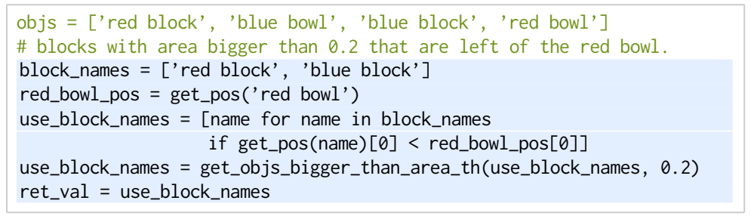
Code as Policies, Google
Prompt:
Hints: import statements that inform the LLM which APIs are available and type hints on how to use those APIs.
Example:
Input instructions are green / Generated Outputs are highlighted
Undefined function

Slide 16
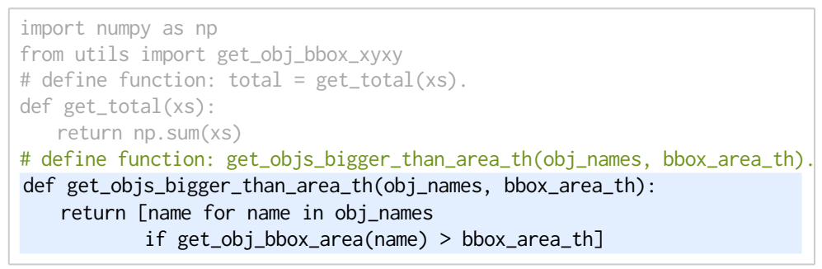
Code as Policies, Google
Prompt:
Identify any undefined functions in the output generated by the LMP, and perform hierarchical function generation to define those undefined functions.

Slide 17
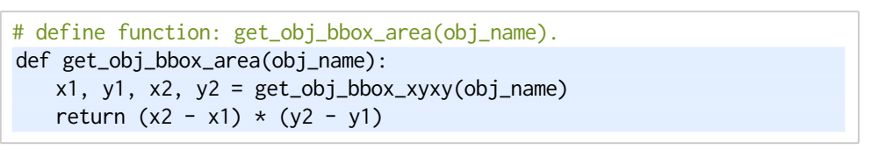
Code as Policies, Google
Prompt:
Identify any undefined functions in the output generated by the LMP, and perform hierarchical function generation to define those undefined functions.

Slide 18
Turtlebot w/LLM (OpenAI)
Installation:
Create an OpenAI Account (https://auth.openai.com/create-account) and API key (https://platform.openai.com/account/api-keys)
Verify that your OpenAI account has some credit (https://platform.openai.com/usage)
Install the OpenAI Python library via pip install openai (It is recommended to utilize virtual environments...)
Clone the code into your workspace (https://github.com/turtlebot/turtlebot4_tutorials)
Build it!

Slide 19
Turtlebot w/LLM (OpenAI)
To run the example, first start the Gazebo simulation, specifying the ‘depot’ world:
Open another terminal and run:
Once the robot is undocked, open a third terminal and run:
$ ros2 launch turtlebot4_gz_bringup turtlebot4_gz.launch.py nav2:=true slam:=false localization:=true rviz:=true world:=depot map:=/opt/ros/jazzy/share/turtlebot4_navigation/maps/depot.yaml
$ ros2 launch turtlebot4_openai_tutorials natural_language_nav_launch.py openai_api_key:=API_KEY parking_brake:=false
$ ros2 topic pub --once /user_input std_msgs/msg/String "data: Dock" $ ros2 topic pub --once /user_input std_msgs/msg/String "data: Go to -1,0, face East" $ ros2 topic pub --once /user_input std_msgs/msg/String "data: Go to 5,5" $ ros2 topic pub --once /user_input std_msgs/msg/String "data: Move to the wooden object" $ ros2 topic pub --once /user_input std_msgs/msg/String "data: Navigate to the item which can hold oil" $ ros2 topic pub --once /user_input std_msgs/msg/String "data: Travel to the room containing a toilet"

